Slide 1

Computer Vision
[ Car ]
Id: 1
Object Tracking &
Counting Vehicles
Milad Goudarzi

Slide 2
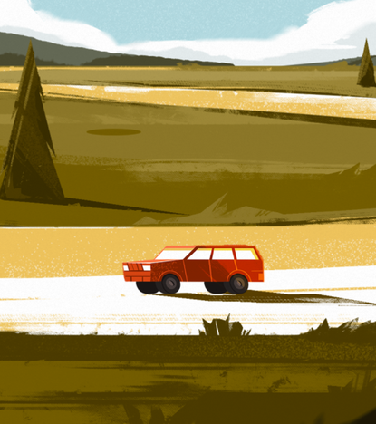
What is object tracking and why do we care?
[ Car ]
Id: 32
Object tracking is following and monitoring the movement of an object in a video or series of images like camera streams.
We care about it because it has numerous applications in real-world in :
surveillance and security
autonomous driving
sports analysis
and many more…

Slide 3
Our Project
Goal: Counting vehicles in a video
Detecting objects
Filter vehicles among detections
Track each vehicle
We tried to detect vehicles in a video and count them. To this end, firstly, we needed to detect vehicles in the video and then keep track of them. Because the counting happens in each frame, and we must not count the same object in each frame. So, we needed something to tell us if we have already counted a specific vehicle and this is where tracking comes into play. So, we needed an object detection model and also a tracker. With that being said…

Slide 4
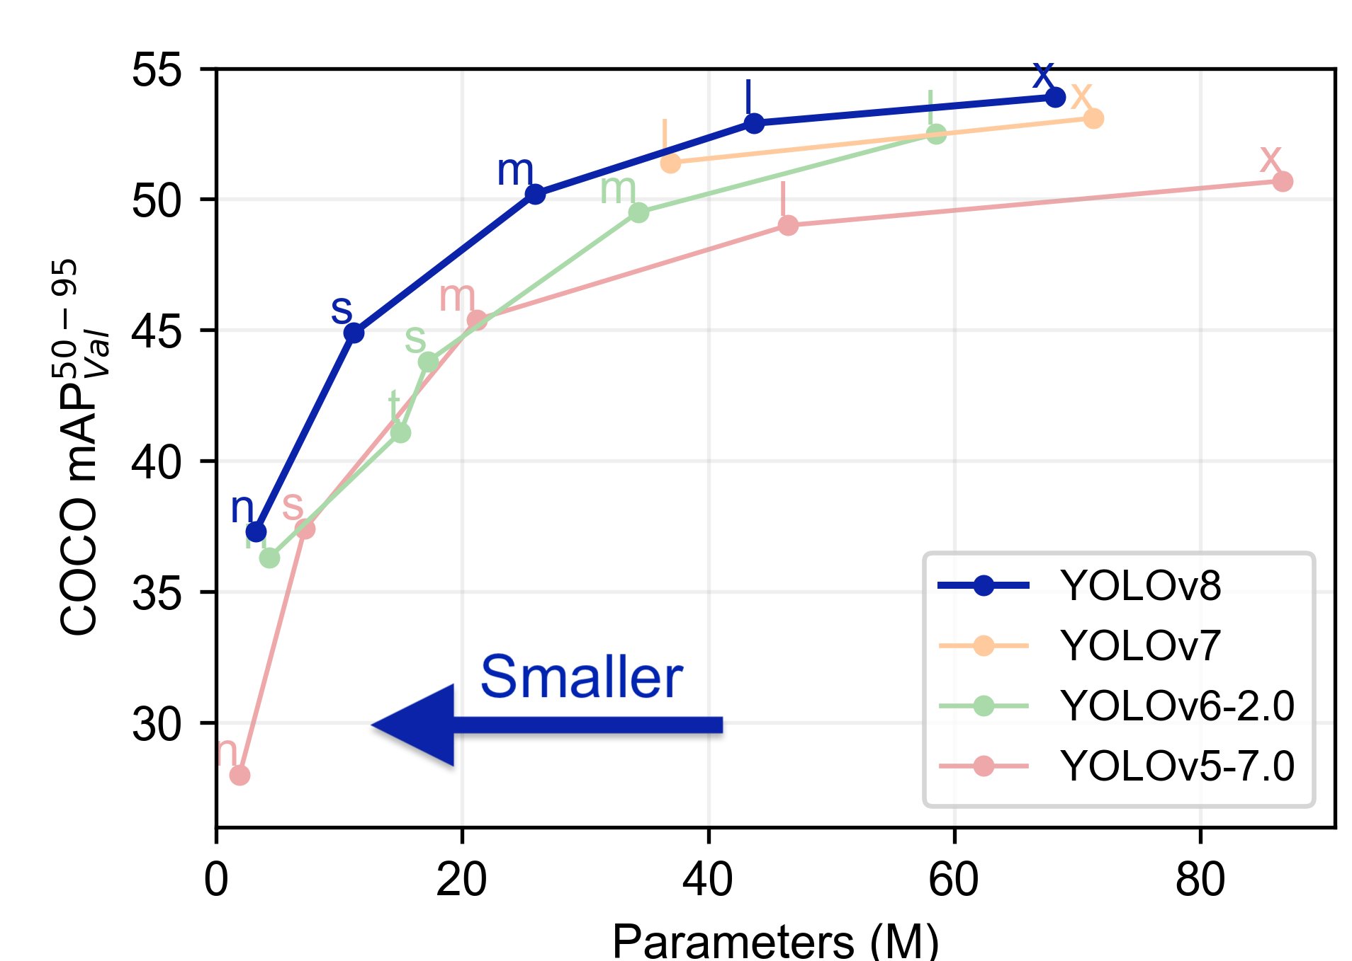
YOLO
You Only Look Once
We chose YOLO as our object detection model which is fast and efficient due to its simple architecture and also not using region-proposal based methods which suggest two different networks for finding bounding boxes and predicting class probabilities. Instead, YOLO predicts bounding boxes and class probabilities in a single shot and hence the name “you only look once”. Moreover, it is quite usual for object detection networks to predict different bounding boxes for the same object. YOLO uses Non-Maxima Suppression to remove redundant boxes, using the intersection over union metric. YOLO comes in different versions and each version, again, has different subversions with different varying parameters number.

Slide 5
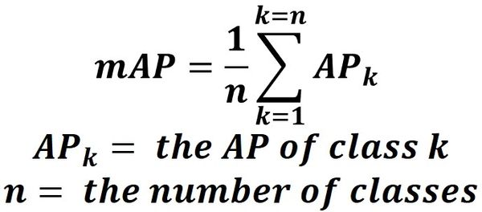
Which YOLO version did we use? Why?
Different versions of YOLO models are compared to each other based on the mAP metric with IoU threshold from 50 to 95 with step size 5. mAP is the mean Average Precision which is calculated according to the formula on the right-hand side (click to see it).
In this formula, first we calculate different precisions for each class based on different IoU thresholds, meaning that we classify a detection as true positive, if the IoU metric between the predicted box and the true box is more than a threshold. After computing these precisions for a specific class, we take the average of them and then repeat the same procedure for other classes as well. Finally, we calculate the mean of these Average Precisions for all classes, and this will be the mAP of the model in question.
Since the mAP of YOLOv8 version x is higher than others, we chose this as our detector. In other words, we traded speed of the model for its accuracy because we weren’t processing videos in real-time.

Slide 6
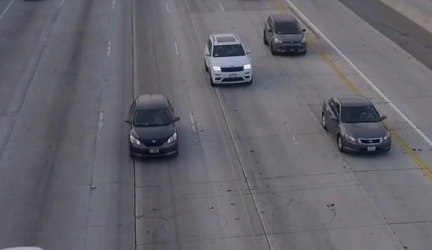
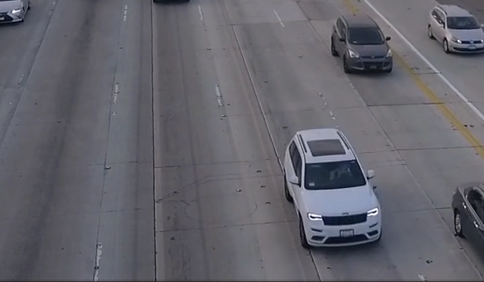
Now that we have our detections by YOLO, why don’t we simply count them? Because this detection is happening on each and every frame and the same vehicle is detected in each frame. If we naively count our detections, after 30 frames, which is usually around 1 second, we will count each vehicle 30 times. Therefore, we need to count each vehicle only once during the whole span of the footage and this is where the tracker comes into play.
Why not simply count the detections?

Slide 7
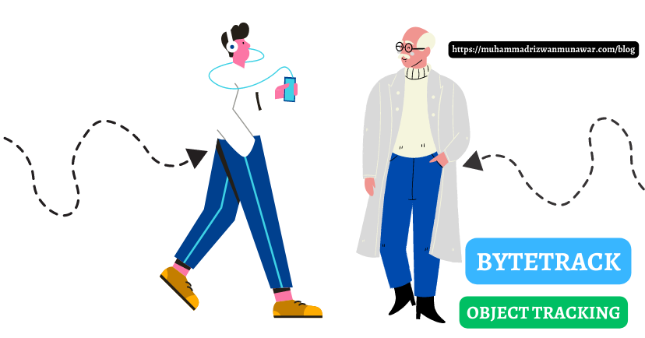
ByteTrack is the tracker we have used in our project, and it is the combination of the so-called BYTE algorithm and YOLOX. BYTE associates detections with tracks effectively. The key advantage of BYTE is that it doesn’t ignore low confidence detection boxes because it considers them as potentially occluded or motion blurred objects. Therefore, it is useful to keep track of occluded vehicles in a cluttered environment. Moreover, it is capable of identifying the same object, even if it leaves the frame and comes back again.
ByteTrack: What is it and how it works?

Slide 8
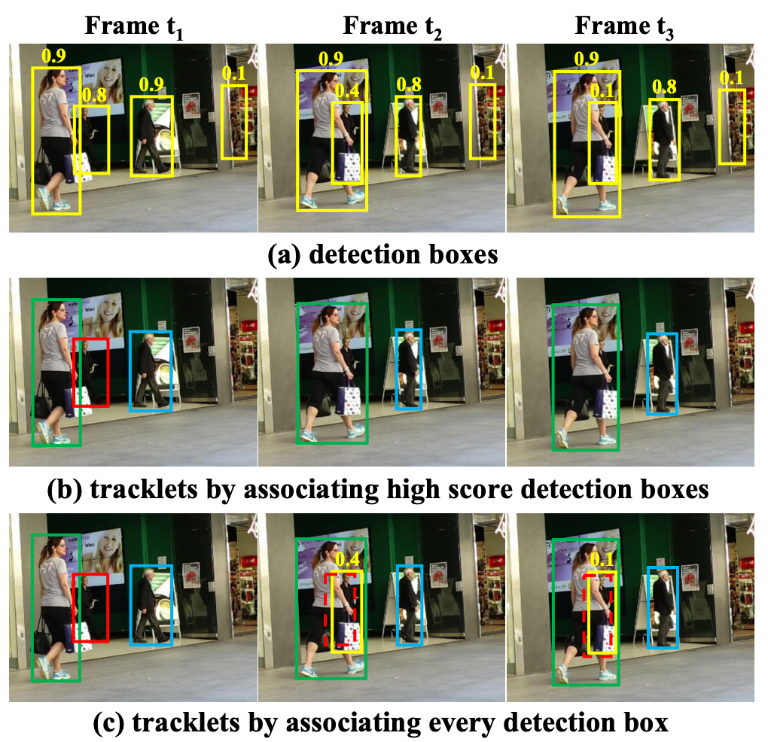
As you can see from the image on the right-hand side, in section (a) in all frames, the detection model could successfully detect people in the scene, but it also detected a part of the background as an object which is a false positive. In the first phase, in section (b) we can see that BYTE tries to associate hight confidence detection boxes to previously initialized tracks and it seems not bad, but in frame t2 it has ignored the red bounding box due to its low confidence. In the second phase, in section (c) BYTE tries to associate low confidence bounding boxes to the remaining unmatched tracks and here we see that the red object is recovered and the piece of background which was wrongly detected as an object is deleted.

Slide 9

Bringing YOLOv8 and ByteTrack together
Object detection by YOLOv8
Tracking by ByteTrack
Now that we have a good detector and a good tracker, why not to combine them and have the best of both worlds? We do the object detection by YOLOv8 and the tracking by ByteTrack and finally we count the tracks which are returned by our tracker.

Slide 10

Now we will see 3 videos, in which we have counted the vehicles moving on the street, each having different conditions compared to each other.
To reduce computation and save resources we did not process the whole frame, since it is not really needed. We chose a Region of Interest (ROI) and applied some color enhancement techniques to increase the contrast in the ROI, and then we passed it to our detector (YOLOv8). YOLO does not detect vehicles only, so we filtered out non-vehicle detections and then forwarded the results to ByteTrack to do the tracking.
As soon as a vehicle is counted, i.e. passed through the red lines, it is shown on the upper side of the video, to make it easier to realize which vehicle is being counted. Finally, we counted the tracks (vehicles) and showed them on the upper left corner of the screen.
Demo Time

Slide 11
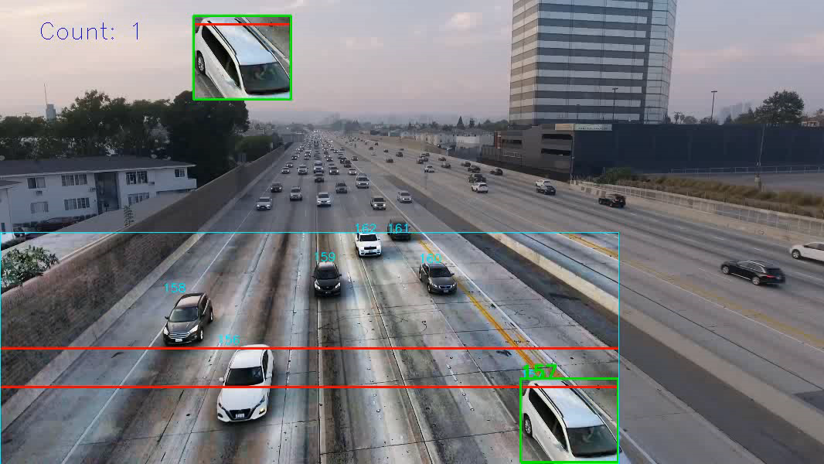
Demo 1
Bridge viewpoint

Slide 12
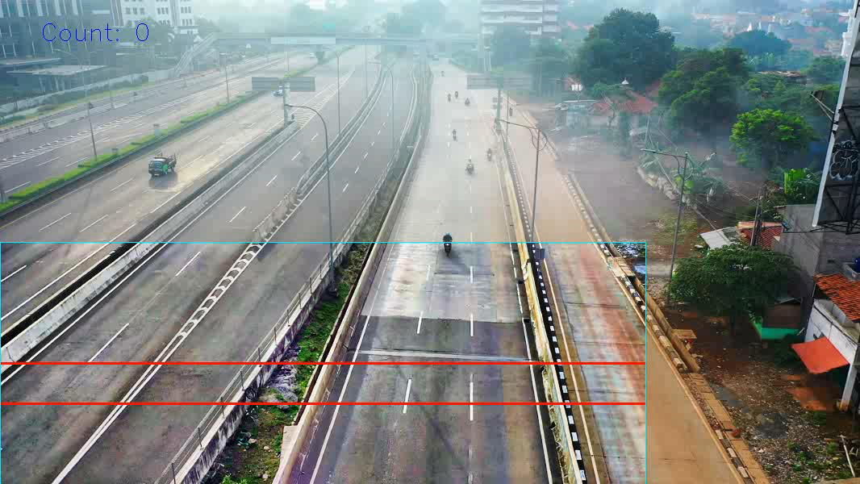
Demo 2
Bridge viewpoint with relatively small vehicles

Slide 13
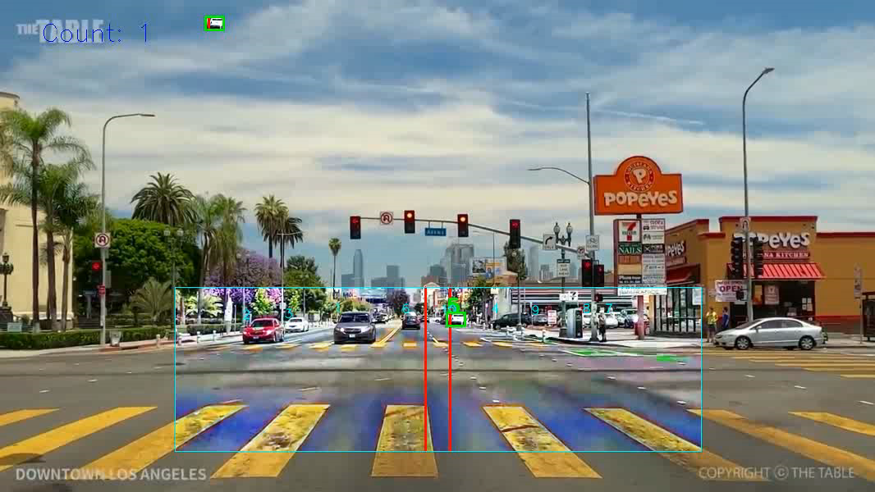
Demo 3
Cluttered environment with far and numerous vehicles

Slide 14
Thank you ☺

